Slide 1
An epidemic of poor nutrition and physical inactivity: Local strategies and efforts to turn the tide
May Okihiro, MD, MS
UH JABSOM Department of Pediatrics
Waianae Coast Comprehensive Health Center

Slide 2
Objectives:
Describe the socio-ecologic model of health and disease
Describe the 5-2-1-almost none campaign
Describe local and national initiatives that are addressing childhood obesity, physical inactivity and poor nutrition
Funding for this project was provided by the HMSA Foundation.

Slide 3
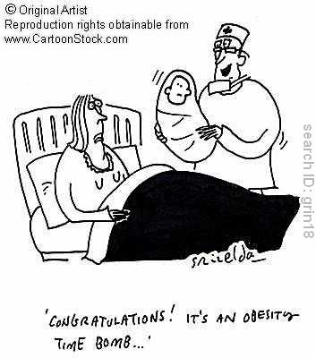
Childhood Obesity Definitions
Overweight
= BMI 85-94.9%
Obese
= BMI ≥ 95%
Funding for this project was provided by the HMSA Foundation.
Notes:
This morning we’re going to talk about childhood obesity, an issue that has received a lot of attention lately….
Most of you know the definitions in children, that as we talk about numbers we are talking about body mass index with overweight being a BMI percentile for age and sex from 85 up to the 95% and obesity defined as a BMI greater than or equal to the 95%

Slide 4
2007-2008
 | ≥ 85% | ≥ 95% | ≥ 97%
All | 31.7% | 16.9% | 11.9%
6-19 years | 34.7% | 18.7% | 13.3%
2-5 years | 21.1% | 10.4% | 6.9%
White 2-5 years | 17.4% | 9.1% | 5.5%
Black 2-5 years | 26.0% | 11.4% | 8.7%
Hispanic 2-5 years | 27.7% | 14.2% | 9.8%
Ogden et al , JAMA 2010
Funding for this project was provided by the HMSA Foundation.
Notes:
So we begin with statistics, not to bore you but to ground you on where we are and drive home the point of the “awful reality” facing our children
The latest national survey, the NHANES from 2007-2008 showed that about a third of our children are overweight or obese with a BMI > 85%. Of these 17% are obese and almost 12% have a BMI% > 97%, a level that even most parents can no longer justify as being chubby.
The numbers show that this is starting earlier.
Over 20% of children 2-5 years is now overweight or obese and when you look at these numbers by ethnic breakdown things get even more worrisome with whites doing much better than children of color. So 26-27% of Hispanic and Black American children, age 2-5 years are overweight or obese

Slide 5
Current State of Hawaii’s Children Health
Unclear - no regular BMI surveillance screening
BMI collected at school entry but data is not analyzed systematically
Pobutsky et a. Hawaii Medical Journal, Oct 2006
Form 14 data at school entry (2002-2003)
N=10,199
28.5% of Hawaii’s children at school entry are overweight or obese
Notes:
How are we doing in Hawaii.
Well, it’s unclear
Unlike many states, Hawaii has NO regular surveillance BMI screening.
BMI is NOW collected at school entry on the Form 14 that we are all so used to filling out, but the data is not analyzed
But a few years ago Ann Pobutsky, a DOH epidemiologist did get some funds to scan the forms into an electronic data base and analyze the data from 2002 to 2003.
She found that 28.5% of Hawaii’s children at school entry are OW or OB
Now remember that Nhanes data we just saw….21% of 2-5 year olds are OW or OB
So our children 8 years ago were more overweight and obese than children are now. And its frightening to think of what the number are now. I don’t think they are better.

Slide 6
Notes:
The data from Pobusty’s study also showed large differences geographically
Because this is school based data, it was reported by school complex.

Slide 7
Notes:
Remember now these are children entering kindergarten

Slide 8
Waianae Coast Comprehensive Health Center Pediatric Data
2000-2003, Children 2 through 19 years
65% Medicaid/Quest and 13.3% uninsured
46% overweight or obese (OW/OB)
Teens 12-19 years BMI ≥ 85%
NH: 52%
Samoan: 77%
Teens 12-19 years, BMI% ≥ 97%
NH: 24%
Samoan: 48.5%
(NHANES 07-08): 13.3% have BMI ≥ 97%
Notes:
We might be touted as one of the healthiest states in the country BUT the numbers indicate that many of our children are not.

Slide 9
Consequences of obesity
“Childhood obesity is like a massive tsunami headed toward the United States”
David Ludwig, Pediatric endocrinologist – Children’s Hospital, Boston
Funding for this project was provided by the HMSA Foundation.

Slide 10
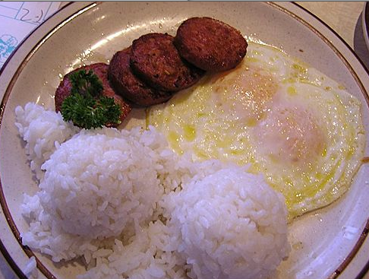
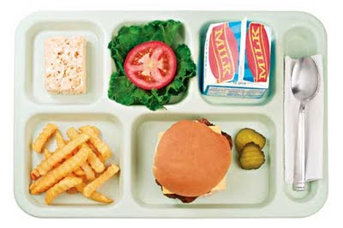
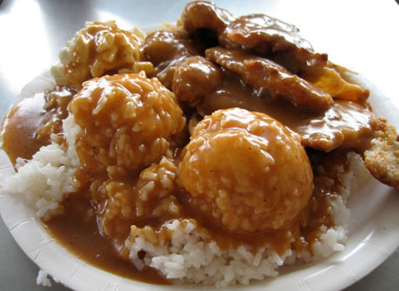
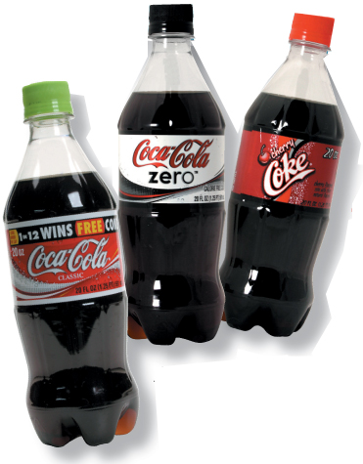
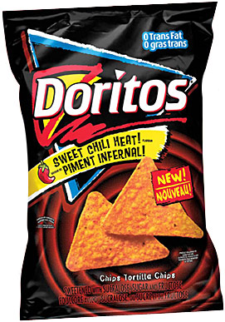
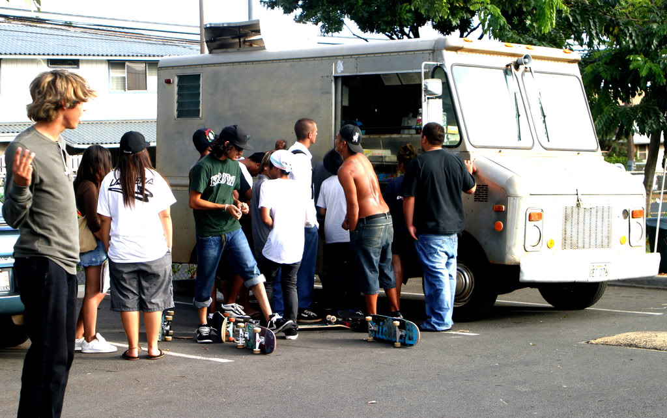
What is the current social norm in Hawaii?
Notes:
So why are things so bad
We all know
This is our social norm – we LOVE food – fat, salt and sugar
It is cheap

Slide 11
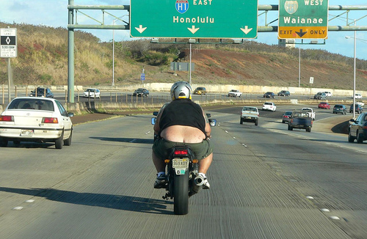
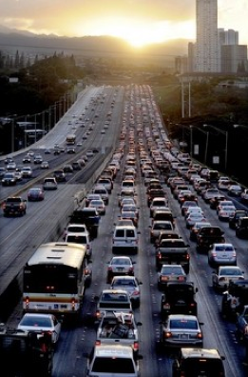
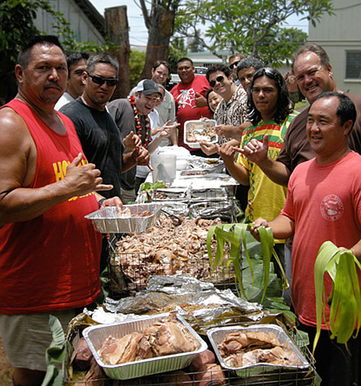
Notes:
And we love TV, movies, computers, videos and cars.
And just about everything around us supports that norm
So what can we do about it

Slide 12
Childhood Obesity Initiative
Initial Meetings - February and May 2008
Organized by Dr. Rudoy, JABSOM Department of Pediatrics and funded by HMSA Foundation
Initial representatives:
AAP-Hawaii
Hawaii Medical Association
UH JABSOM, Dept of Pediatrics, Native Hwn Health, Complementary and Alternative Medicine, Office of Public Health Sciences
Hawaii Department of Health
Community Health Centers
Notes:
So 2 years ago now, HMSA Foundation, realizing that they and many others were spending a lot of time and money in this area, sponsored a series of meetings about childhood obesity in Hawaii.
Representatives from UH School of Medicine, Nursing, Office of Public Health Studies, Department of Health, Medicaid and others attended and we came to some obvious conclusions
That ….

Slide 13
Recognized:
The extent and severity of childhood obesity is worsening
Especially from low-income communities
Childhood obesity (CO) is a super-duper complex problem
Out: The moral model (obesity is a sign of gluttony, weakness, laziness etc.)
In: Socio-ecologic model
CO Prevention and Management requires collaborative, comprehensive approaches

Slide 14
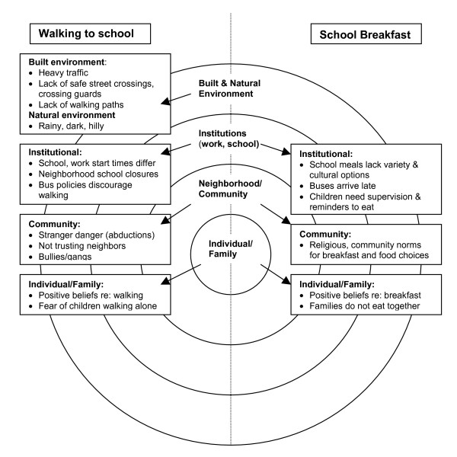
Notes:
•We agreed that That obesity can no longer be looked up as simply a problem of the individual
•The socio-ecologic model recognizes the interwoven relationship between an individual, their family, their community and the rest of the environment
•While individuals are responsible for instituting and maintaining the lifestyle changes necessary to reduce risk and improve health, individual behavior is determined to a large extent by social environment, e.g. community norms and values, regulations, and policies.
•Barriers to healthy behaviors are shared among the community as a whole. As these barriers are lowered or removed, behavior change becomes more achievable and sustainable. It becomes easier to "push the ball up the hill.”
•The most effective approach leading to healthy behaviors is a combination of the efforts at all levels--individual, interpersonal, organizational, community, and public policy.

Slide 15
Recommendations:
Hawaii Initiative for Childhood Obesity Research and Education (HICORE)
Mission: To provide collaborative and multi-disciplinary leadership in research and education targeting childhood and adolescent obesity in Hawaii in order to improve the health and wellness of Hawaii’s families now and for future generations.
Emphasis on the most vulnerable children and families
Funded by HMSA Foundation – January 2009

Slide 16
Goal 1: To serve as a repository of child and adolescent obesity projects in Hawaii:
Create, develop and maintain a HICORE Internet web page: www.hicore.org
Research: repository of CO projects in HI
Resource: Education and Research
Funding for this project was provided by the HMSA Foundation.
Notes:
Here’s what has happened since January
One of the most important tasks was developing a website to serve as the repository for childhood obesity projects, that would inform users of educational opportunities related to childhood obesity and become a resource page for issues related to education and research related to childhood obesity in Hawaii

Slide 17
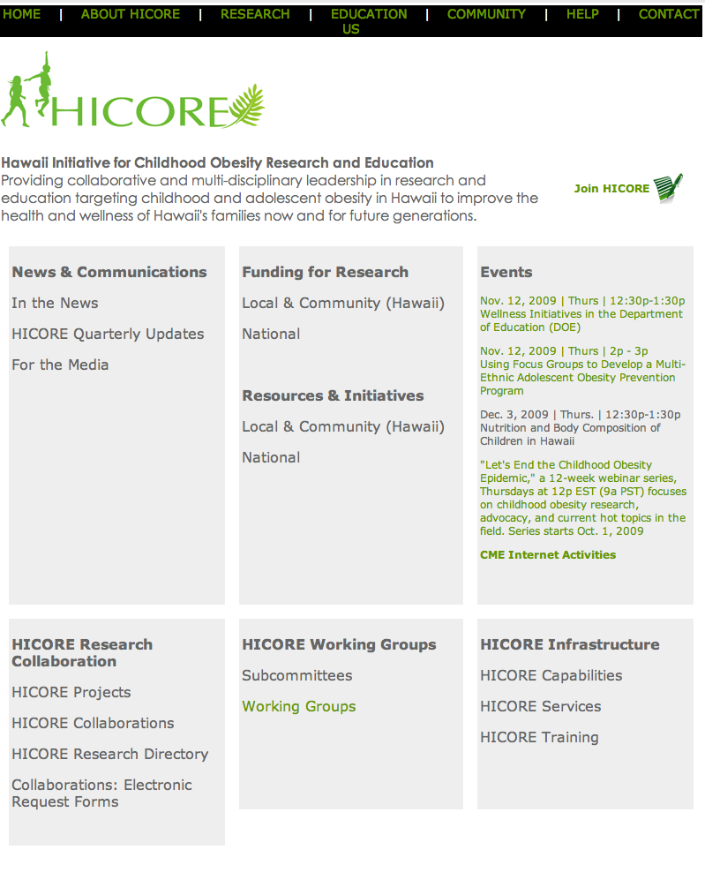
Funding for this project was provided by the HMSA Foundation.
Notes:
With the hard of our operations manager Romelynn Stein and our IT support, Jen Char, we’ve recently launched the HICORE website.
It is still under construction but it will become a resource center for the educational and research efforts going on in Hawaii related to childhood obesity.
We’ve also received preliminary approval to have an MPH student help us catalog as many of the current obesity related projects based in Hawaii and/or involving Pacific Islanders. This will enable researchers and educators to build from what is being done rather than starting from scratch. We hope to have downloads or links to the findings of each study making it easier for people to learn from each other and to understand the breadth and depth of the efforts in Hawaii.

Slide 18
Goal 2: To provide guidance to local granting agencies and foundations regarding research on childhood and adolescent obesity in Hawaii
Establish a multi-disciplinary Scientific Advisory Committee (SAC) to review submitted grant proposals for granting agencies and foundations, HMSA Foundation and others
Prioritize areas of CO research needed in Hawaii

Slide 19
Goal 3: To serve as a center for the education in the area of childhood and adolescent obesity in Hawaii
CME Series for Community Child Health Providers - focus on CO, physical activity, nutrition and health disparities
Partners:
Kapiolani Medical Center
AAP-Hawaii
RCMI-NIH
NOW available as “enduring” activity at www.hicore.org
Notes:
In order to address the need for more training in the area of childhood obesity we’ve initiated a monthly CME series for community child health care providers. The focus will be on CO, PA, nutrition, the prevention of chronic disease and health disparities
We are partnering with the Academy of Pediatrics, Hawaii chapter and hopefully with KMC in this effort
We would like to reach providers across Hawaii so we are trying new ways to make this web-based, which for those who have tried webinars in the past, know that it can be a less than perfect…but we’re getting there.
We are working with the UH JABSOM folks in charge of CME to be able to archive materials through and “enduring CME program” that will allow us to offer web-based seminars that child health providers can access on their own time to learn about CO issues in Hawaii.

Slide 20
Goal 3: To serve as a center for the education in the area of childhood obesity in Hawaii
Faculty development
Resident and medical student training
“Library” and other resource materials
Conduct an annual Research/Education Conference
Aim: April 2010
Work with health insurance companies and other partners to encourage CO education through incentives etc.

Slide 21
Goal 4: To conduct research on child/adolescent obesity relevant to people of Hawaii
Community-based participatory research
Socio-ecologic approach to CO research
CO research priority areas
Grants
Kaiser Grant – Evaluate Hawaii Pediatric Weight Management Toolkit
U01 – Fun5/A+/Community and families

Slide 22
State of Hawaii, Healthy Hawaii Initiative
Hawaii DOH’s statewide health promotion campaign
Notes:
The Healthy Hawaii Initiative (HHI) is the DOH program responsible for running the Start Living Healthy campaign.
HHI's structure is based on the social-ecological model to affect behavior change at multiple levels of society (individual, interpersonal, organizational, community, and societal).
The Healthy Hawaii Initiative is made up of five interrelated components:
Schools
Community Programs
Public and Professional Education
Research and Evaluation
Nutrition Education Network

Slide 23
Hawaii Nutrition and Physical Activity Coalition (NPAC) :
Established 2007 under HHI as a FU of the PAN Plan
Advocate for initiatives and policies that will support optimal physical activity and nutrition in Hawaii’s people
Based out of the UH Office of Public Health Studies
Funded by Hawaii Health Initiative (Tobacco Settlement)
State Chair: Larry Bush - Executive Director - YMCA Honolulu
State Vice-Chair: Daniel Leung, KCC Culinary Arts
State Director: Jennifer Dang

Slide 24
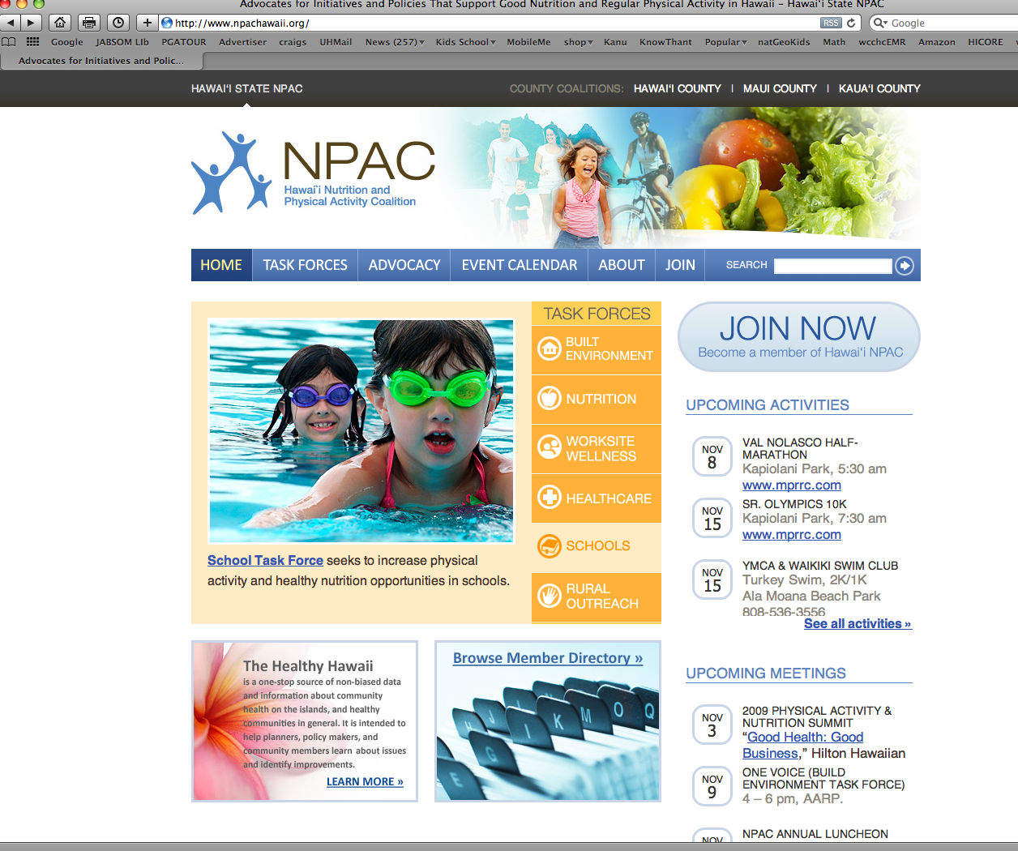

Slide 26
NPAC Taskforce
School Taskforce
Don Weisman, State Chair (American Heart Association)
Promotion of physical activity in schools
Nutrition Taskforce
Daniel Leung (KCC Culinary Arts) and Kristina Cuthrell (UH CTAHR)
Promotion of healthy foods especially in schools
Worksite Wellness
Promotion of wellness at work
Built Environment
Justin Fanslau
Advocates for complete streets, safe routes to school, pedestrian and bicycle safety

Slide 27
NPAC Healthcare Taskforce
Members –
Physicians
State of Hawaii DHS – Quest Services
HMSA
Alohacare
UHA
Hawaii Dept of Health
Maternal Child Branch
Hawaii Health Initiative
Kapiolani Medical Center
National Kidney Foundation
American Cancer Society

Slide 28
NPAC Healthcare Taskforce - Strategies
Increase BMI screening
Individual level: Clinics/providers - new HEDIS 2009 guidelines
Surveillance: Schools
2. In an effort to change the social norm, promote and encourage consistent messaging by all:
Ex: 5-2-1-0

Slide 29
Evidence and Action
Is there sufficient evidence to make positive recommendations and to take action?
Recognize: Action is needed NOW
Action should be based on inferences from the best evidence that is now available
The probability of harm from INACTION is GREATER than the probability of harm from actions taken
Notes:
In deciding on what to do to prevent and manage childhood obesity, many experts in this area, including researchers, clinicians and public health experts have used the following rationale.
Is there sufficient evidence to make positive recommendations and to take action?
We know the problem is bad, not just for children but for families and communities.
Our data from Hawaii, though sparse is clear, that action is needed now
So the question faced is the following:
The answer is YES
The data supports that action is needed now.
Action show be based on inferences from the best evidence that is now available
The probability of harm from INACTION is GREATER than the probability of harm from actions taken

Slide 30
Evidence-supported Targeted Behaviors
Barlow SE et al. Pediatrics Dec 2007
Limit sugar sweetened drinks
Encourage consumption of diets with recommended quantities of Fruits/Veggies
Limit television and other screen time (and no TV in bedroom)
Eat breakfast daily
Encourage family meals
Limit portion size
Notes:
And so a panel of experts was convened by a joint efforts sponsored by the AMA, the CDC, the Health and Human services Dept, AAP
They poured over the available best research and reports and found evidence to support the following targeted behaviors to prevent excess weight gain that that these behaviors were unlikely to cause harm

Slide 31
Three Household Routines
Anderson et al, Pediatrics Feb 2010
Three household routines (4 year olds)
Eating dinner regularly as a family
TV time < 2 hours/day
Sleep at least 10.5 hours/night
Funding for this project was provided by the HMSA Foundation.

Slide 32
Additional recommendations:
Eat a diet rich in calcium
Eat a diet rich in fiber
Eat a diet with balance micronutrients
Encourage exclusive breastfeeding to 6 mo
Moderate to vigorous PA for at least 1 hour /day
Limit energy dense foods
Barlow SE et al. Pediatrics Dec 2007

Slide 33
Simplification: 5-2-1-almost none
Consume 5 fruits and vegetables a day = 5
Limit screen time to 2 hours or less per day = 2
Engage in 1 hour or more of physical activity per day (moderate to vigorous exercise) = 1
Consume no sugary beverages each day = 0

Slide 34
http://www.nemours.org/department/nhps/five-two-one.html

Slide 35
http://www.letsgo.org/resources/MYOC.php?id=greenHealth&vid=v10
Notes:
A community based in Maine initiative called “let’s go” really took off with this

Slide 37
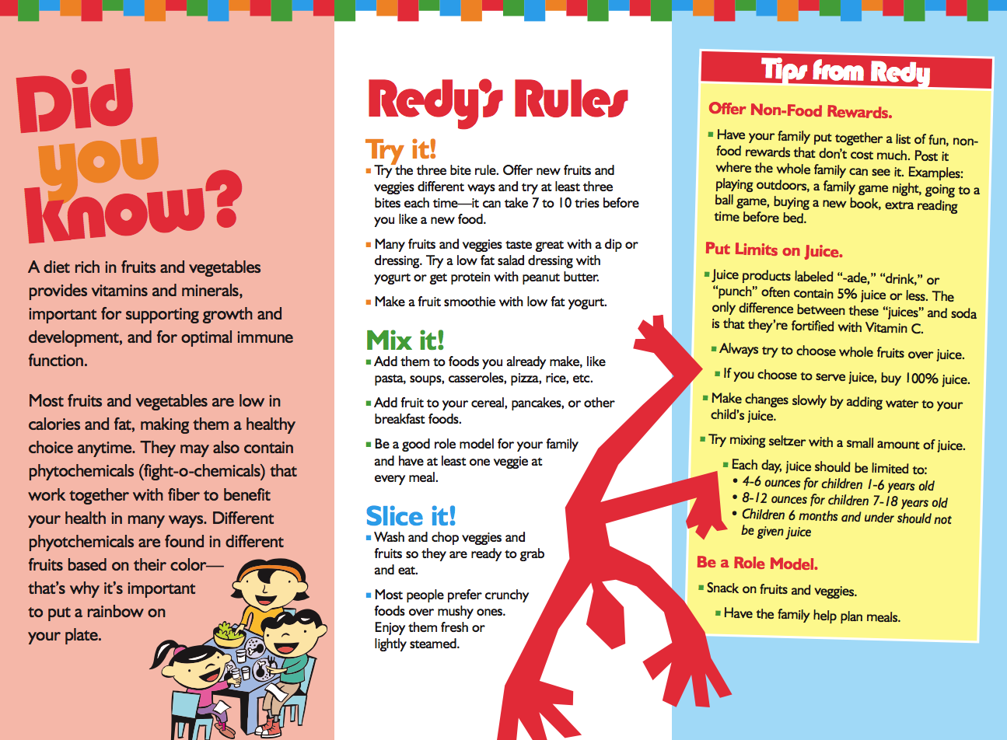

Slide 40
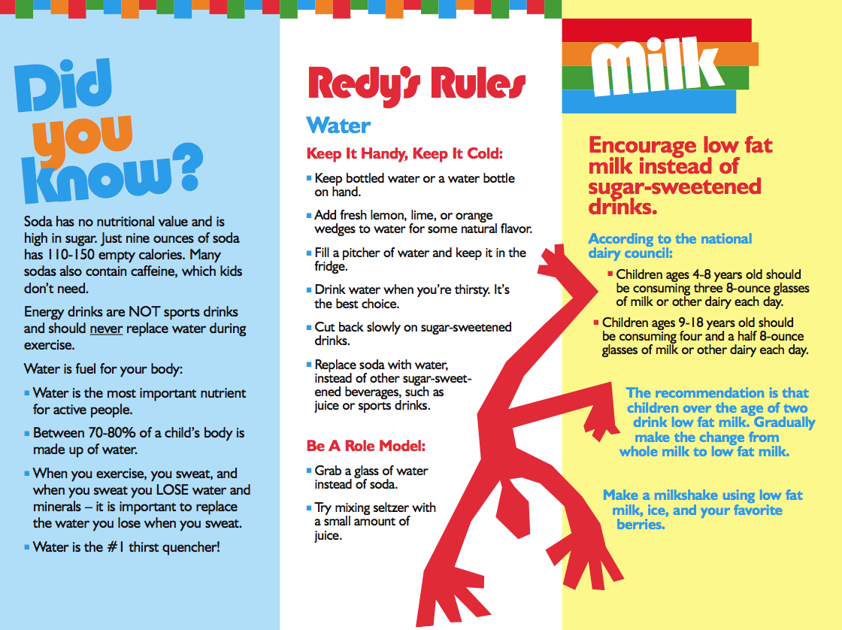

Slide 43
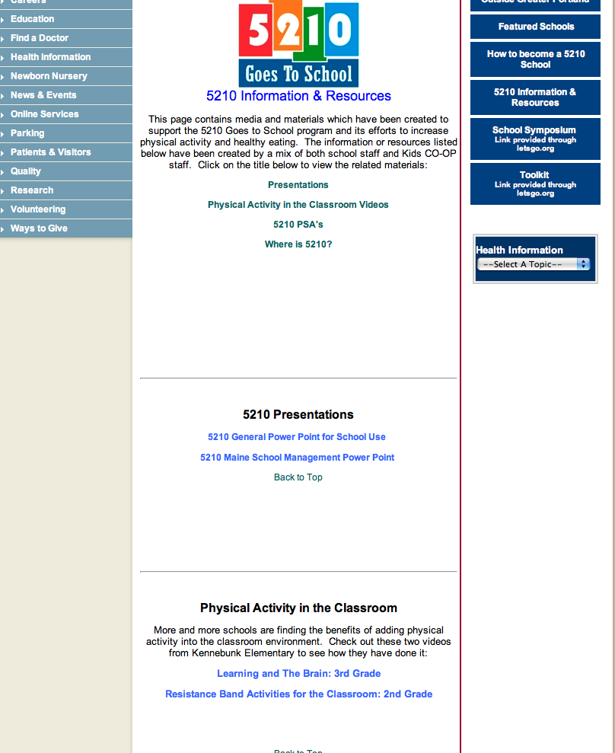

Slide 44
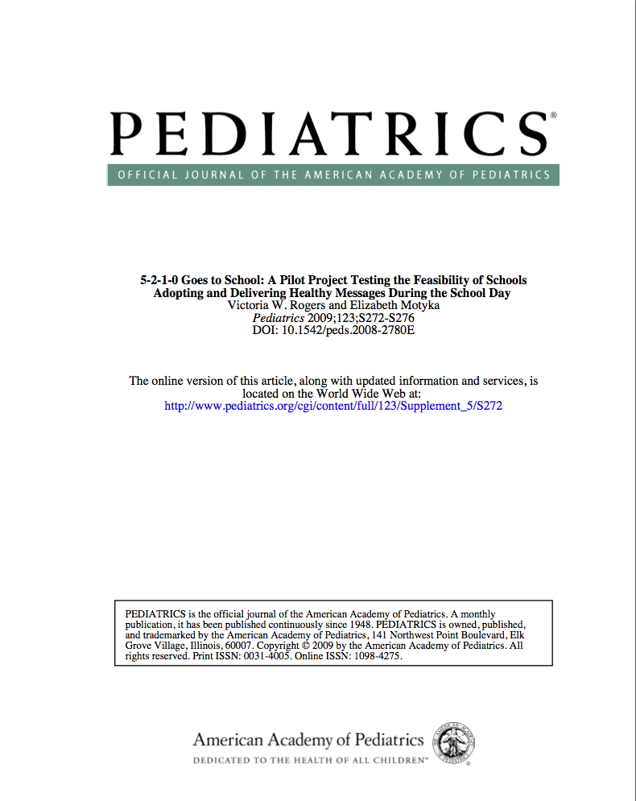
Most administrators and teachers more aware of 5-2-1-0 message
Half parents more aware of message
80% of teachers found Toolkit easy to use
90% of teachers would be willing to continue implementation
2/5 parents reported receiving educational handouts
Students responded positively

Slide 49
5-2-1-almost none!
Slogan and campaign provides a simple “road map” for attaining a healthier lifestyle
Tailored to help children and parents better understand concrete ways to live a healthy life
Enables parents/children/families to focus initial efforts and frame further attempts at adopting behavioral change
Now used in 40% of regional social marketing campaigns
Notes:
Parents play key role in facilitating weight control and living healthy lifestyle
5-2-1-almost none campaign gives parents and families a clear direction for actionable behaviorsl so they are in a better position to partner with their children and health care team

Slide 50
Localize it!
Venues
Pictures
Words
Elima, ekolu…
Mascot
Spokesperson
Music
Events
Health systems
Health centers
Physician offices
Hospitals
Schools
Child care centers
Sports facilities
Worksites…..

Slide 51
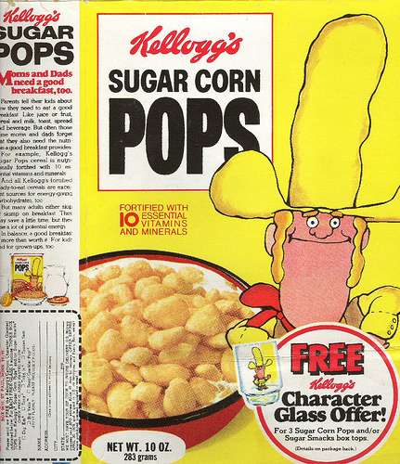
Goal: Change the social norm, one step at a time

Slide 52
Let’s Move!!
What: National campaign to “tackle” the challenge of childhood obesity
Who: The Obamas, the Federal Government and everyone else
Goal: To solve the epidemic of childhood obesity within a generation
How: A comprehensive approach
Builds on effective strategies
Engages families and communities
Mobilizes both public and private sector resources
Funding for this project was provided by the HMSA Foundation.

Slide 53
Presidential Memorandum: Establishing a Task Force on Childhood Obesity
Mandate: To develop an interagency action plan to solve the problem of childhood obesity within a generation
Chair: Assistant to the President for Domestic Policy
Membership:
Secretaries of Interior, Agriculture, HHS, Education
Director of Management and Budget
Asst to the President and Chief of Staff to First Lady
Asst to the President for Economic Policy
Heads of other executive departments, agencies as Chair designates
Funding for this project was provided by the HMSA Foundation.

Slide 54
Mission and Function:
The functions of the task force as to make recommendations to meet the following objectives
Ensure access to healthy, affordable food
Increase physical activity in schools and communities
Provide healthier foods in schools
Empower parents with information and tools to make good choices for themselves and families
Funding for this project was provided by the HMSA Foundation.
Notes:
Sec. 2. Mission and Functions of the Task Force. The Task Force shall work across executive departments and agencies to develop a coordinated Federal response while also identifying nongovernmental actions that can be taken to solve the problem of childhood obesity within a generation. The functions of the Task Force are advisory only and shall include, but are not limited to, making recommendations to meet the following objectives:
….
Sec. 3. Interagency Action Plan. Within 90 days of the date of this memorandum, the Task Force shall develop and submit to the President a comprehensive interagency plan that:

Slide 55
The Obama Initiative and the AAP
The AAP has pledged to engage in several efforts with 2 primary goals:
Body Mass Index (BMI) is calculated for every child at every well-child visit
Information is provided to parents about how to help their child achieve a healthy weight; and
Prescriptions for healthy active living (good nutrition and physical activity) are provided at every well-child visit, along with information for families about the impact of healthy eating habits and regular physical activity on overall health
Funding for this project was provided by the HMSA Foundation.
Notes:
The White House and the Obamas have engaged the American Academy of Pediatrics in this effort.

Slide 57
Will it work? Will it help?
Impact of appropriate counseling:
Evidence: obese patients who receive appropriate counseling from their physicians are more likely to begin a weight management program than those who do not
Most pediatric providers:
Feel childhood obesity is a very important issue
Are concerned about their patients
Want to learn more about strategies to manage overweight patients
BUT multiple barriers exist
Funding for this project was provided by the HMSA Foundation.

Slide 58
Real and Perceived Barriers
Lack of parent involvement
Lack of patient motivation
Lack of support services
Perceived low efficacy in behavior management strategies, parenting techniques and addressing family conflict
Request – more training
Funding for this project was provided by the HMSA Foundation.

Slide 59
More Training? The Right Training
Pediatricians who received recent CME about childhood obesity prevention and management
Are more familiar with expert guidelines
More likely to use BMI as a screening tool
Felt more confident screening, counseling patients and families (Klein, Pediatrics 2010)
Barlow:
“The complexity of obesity prevention (and management) lies less in the identification of target health behaviors and MUCH more in the process on influencing families to CHANGE behaviors “
Funding for this project was provided by the HMSA Foundation.
Notes:
Handing families a list of recommended eating and activity habits as if it were an antibiotic prescription fits into traditional medical training but such an approach is rarely effective.

Slide 60
Motivational Interviewing Patient-Centered Communication
Recommended: Pediatric Obesity Prevention Writing Group, IOM, others
Assumes that the clinician’s instruction to change a behavior (bad eating, drinking, smoking) will only be effective if the patient/family/parent recognizes a potential problem and wants to address or prevent it
Based on the “Stages of Change” theory
Clinician helps to motivate the patient/family by helping them move along these stages rather than prescribing a new behavior to those who are not ready
Importance or confidence rulers are used to set goals and problem solve
Funding for this project was provided by the HMSA Foundation.

Slide 61
Funding for this project was provided by the HMSA Foundation.

Slide 62
Timely Topics: Program
Morning:
Welcome and Intro
Childhood obesity and the Healthcare Provider: Scott Gee, MD
Building Blocks for Nutritionally Competent Children, Christine Wood MD
Childhood Obesity Inside and Outside Your Office, Christine Wood
Afternoon: Motivational Interviewing Workshop
Contact: Kathy Sthay, AAP-Hawaii Chapter
www.hawaiiaap.org
Funding for this project was provided by the HMSA Foundation.

Slide 63
Let’s Move!
We believe every kid has the right to a healthy childhood.
We CANNOT let this be the first generation in our history to grow up less healthy than their parents.
The ingredients…better food + more activity…are clear.
Let’s Move isn’t just noble, it’s a necessity.
It’s not just a slogan, it’s our responsibility
Are you with us? Let’s move Hawaii!
Funding for this project was provided by the HMSA Foundation.

Slide 64
This work was supported by:
HMSA Foundation
NIH, National Center for Minority Health and Health Disparities Grant No:P20MD000173

